Slide 1
Be + Adjectives
Basic 1 – Unit 3 Lesson B

Slide 2
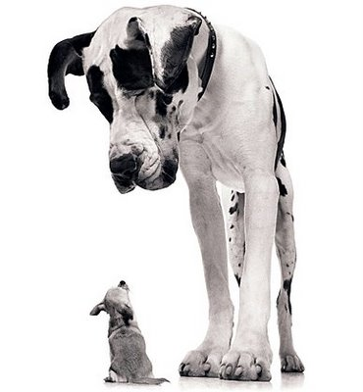
This is a big dog.
This dog is big.
That dog is small.
That is a small dog

Slide 3
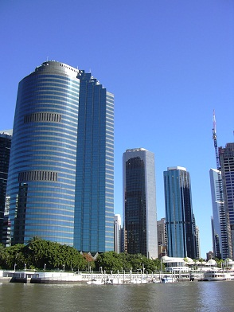
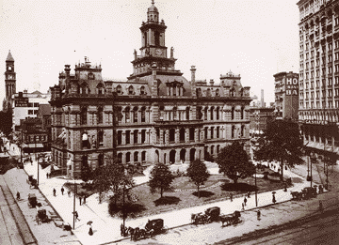
This building is old
This is an old building
These buildings are modern
These are modern buildings

Slide 4
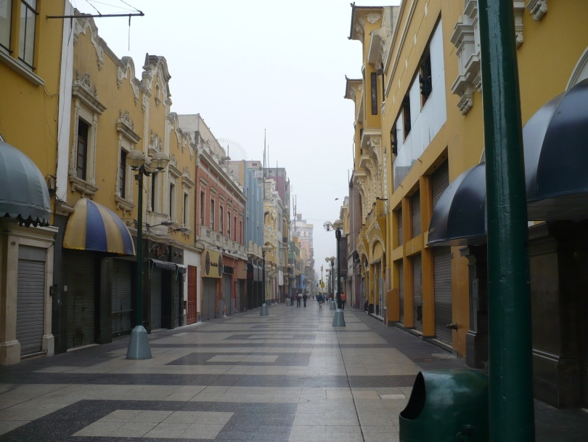
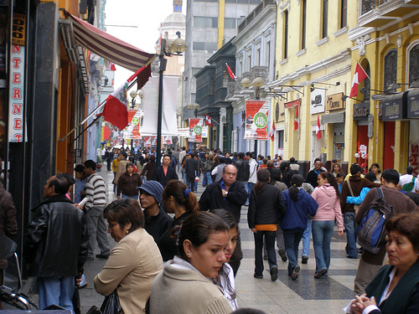
This street is empty.
This street is crowded.
This is an empty street.
This is a crowded street.

Slide 5
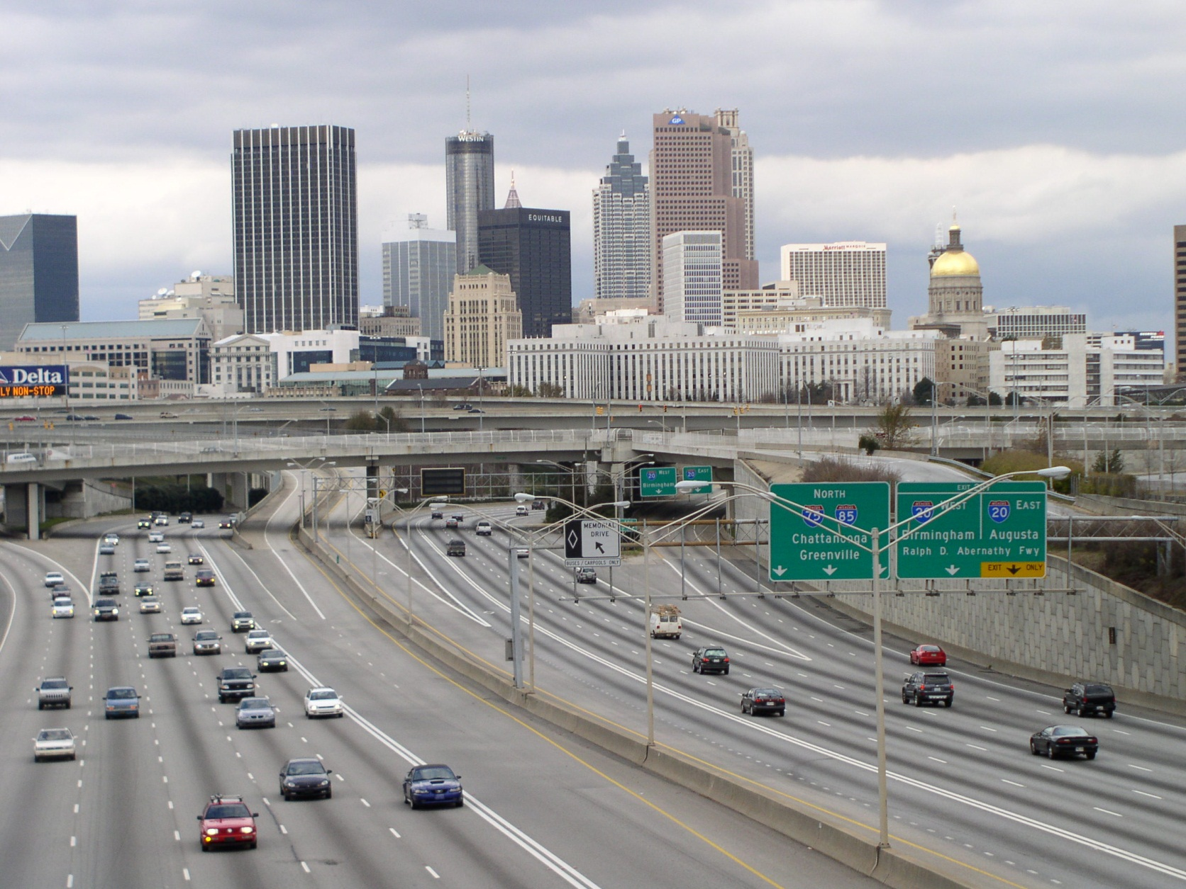
Atlanta is a big modern city.
Atlanta is big and modern

Slide 6
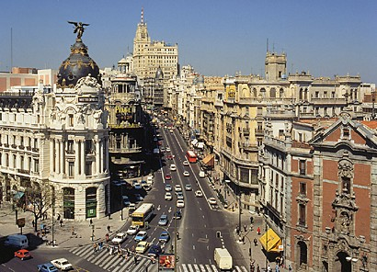
Madrid is an old city.
Madrid is old.

Slide 7
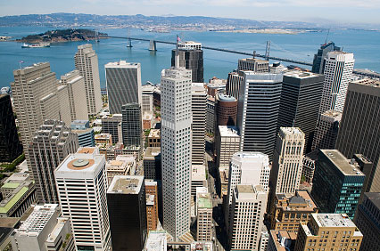
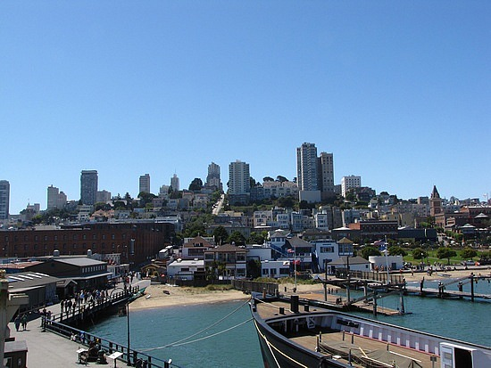
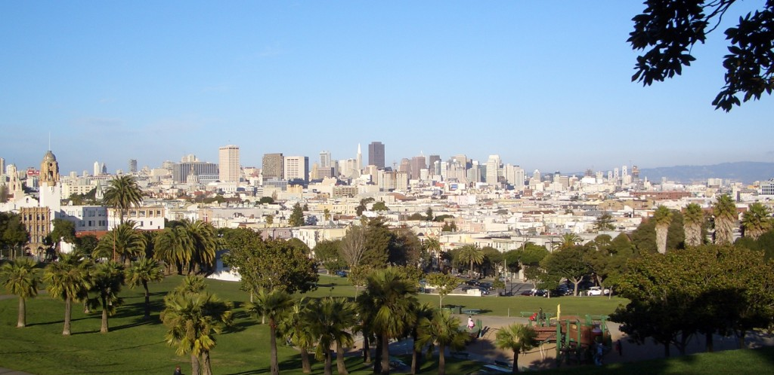
San Francisco is a beautiful city.
There are modern buildings and big parks.

